Slide 1
Riparian Zones
Riparian Buffers Affects on Rivers

Slide 2
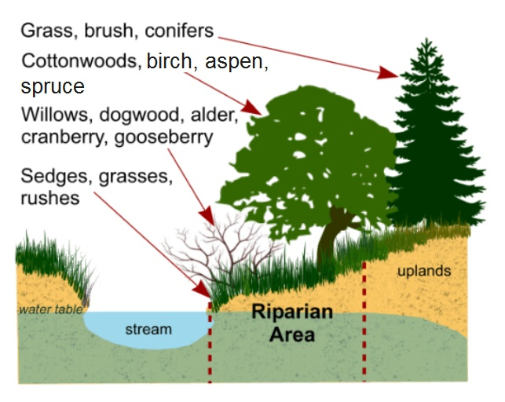
What is a Riparian Zone?
Riparian Zones are the areas bordering a river or stream
Naturally, Riparian Zones tend to be forested areas, however human development can cause the riparian zones to be something else such as:
  Agriculture fields, pavement (parking lots or roads), mowed areas, gravel or stone, compacted dirt, and more

Slide 3
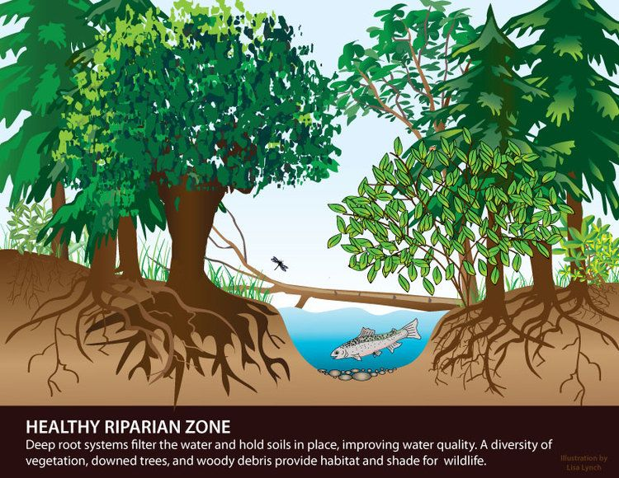
Why are Riparian Zones Important?
Healthy, natural Riparian Zones are important for both the environment and people
Riparian Zones can:
  Slow Flooding
  Filter Water
  Prevent Contaminated Runoff and Pollution
  Provide Habitat
  Prevent Erosion
  Protect Homes from Erosion, Flooding, and Other River Caused Issues

Slide 4
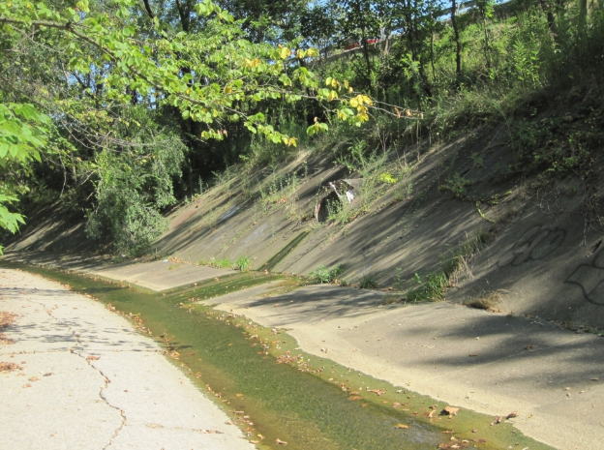
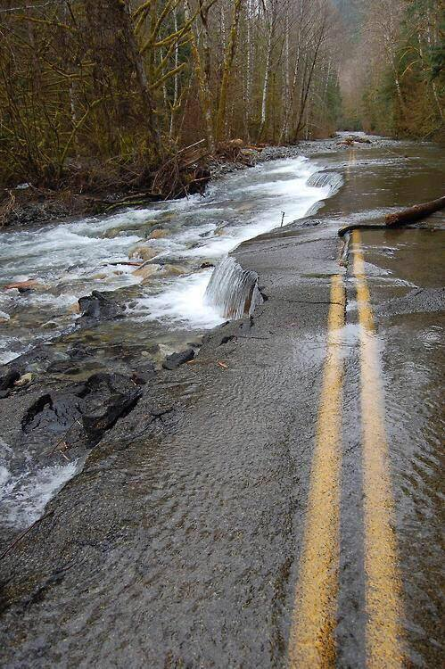
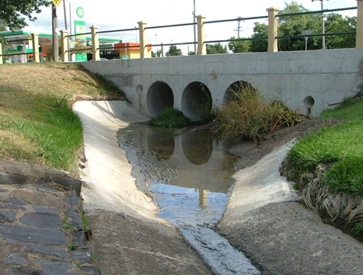
Pavement Riparian Zones
First trial represented: Pavement
  This may be seen because of parking lots or roads
Water can’t infiltrate soil, so it runs directly into rivers
Water moves fast and carries any contaminants straight to rivers
This causes water pollution and flooding

Slide 5
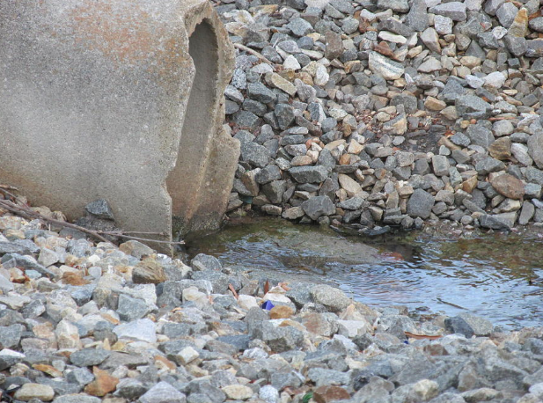
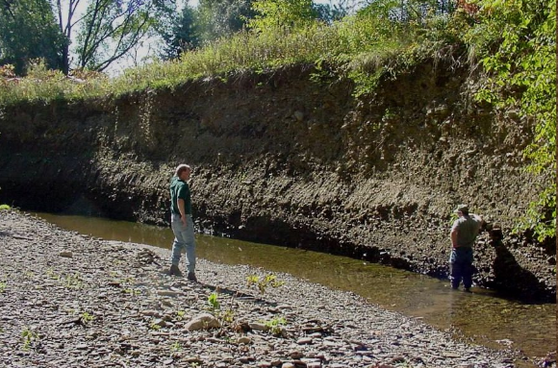
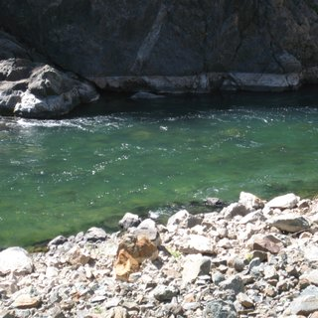
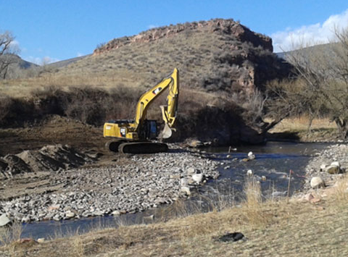
Gravel Riparian Zones
Second trial represented: Gravel or Rocky Riparian Zones
  This could occur because a park, playground, driveway, or the removal of soil/erosion
Water moves through gravel, however, large pieces provide very little resistance
Water still moves fast and can carry contaminants straight to rivers
This causes water pollution and flooding

Slide 6
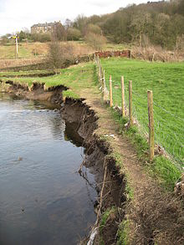
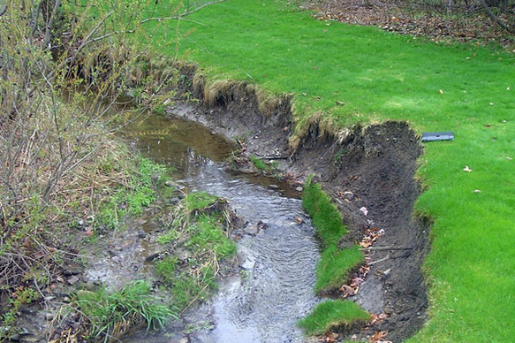
Soil Riparian Zones
Third and Fourth trial represented: Soil Riparian Zones
  This could occur because lack of vegetation to hold soil, created by agricultural fields, overgrazing, mowing…etc…
Water still moves slower and some contaminates will be removed. However, soil can be washed into rivers, creating heavy sedimentation and erosion of the land
This causes water pollution, some flooding, erosion and collapse of riverbanks

Slide 7
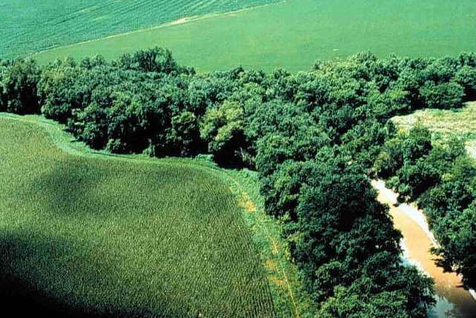
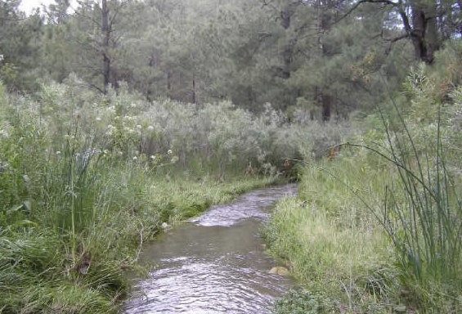
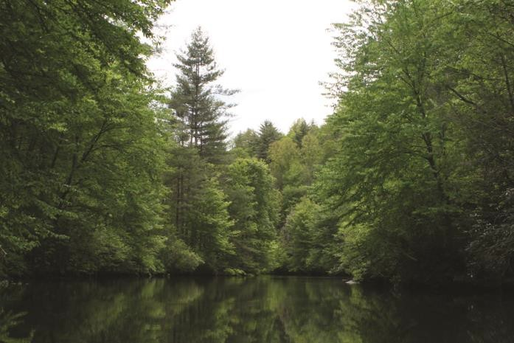
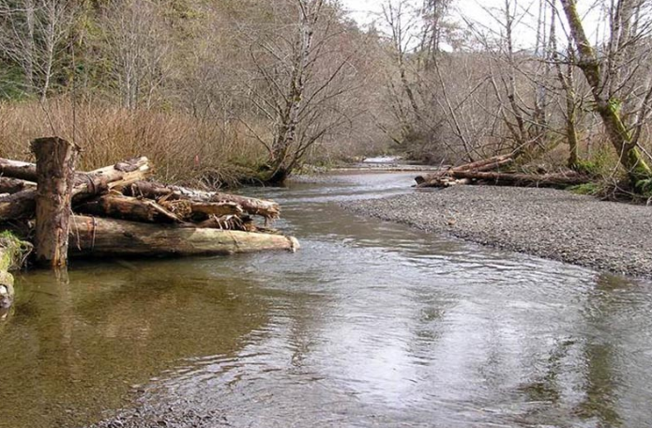
Vegetated Riparian Zones
Fifth trial represented: Vegetated Riparian Zones
  This occurs when Riparian Zones grow naturally
Water moves slowly. It is held up by layers of detritus, vegetation leaves, and vegetation roots. Plants even remove some water by absorbing it. The roots also holds the soil so it does not erode.
The slow infiltration of water through the natural substrate filters and captures pollutants.
This prevents water pollution, quick flooding, and collapse of riverbanks

Slide 8


Special Thanks To:
Appalachian Watershed Research Group
The Voinovich School of Leadership & Public Affairs
Ohio University
AEP Foundation

